Slide 1
Fine-Tuning Transformers for Toxicity Detection: A Sentiment-Informed Approach
Melody Masis
December 9, 2024

Slide 2



1. Problem: Toxicity Detection in Comments

Slide 3


Dataset: Toxic Comment Classification Challenge
Comments
Training data: 127,656 rows
Validation data: 31,915 rows
Test data: 153,164 rows
Data Splits: 20% validation set

Slide 4
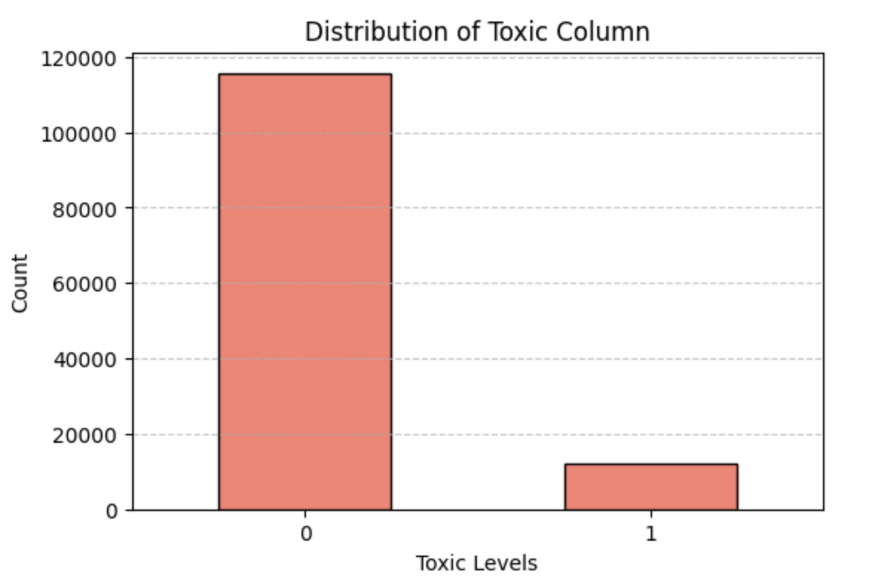
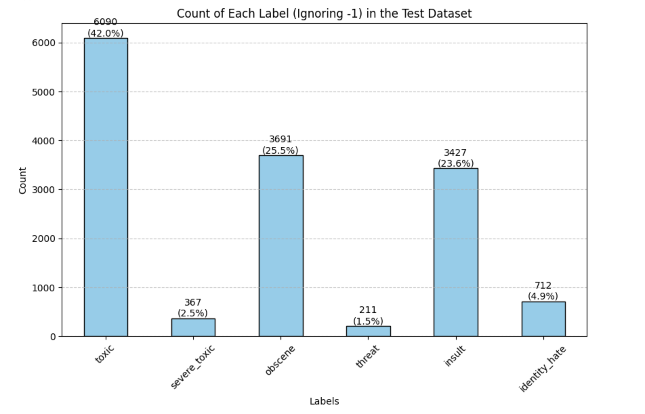
EDA Highlights

Slide 5
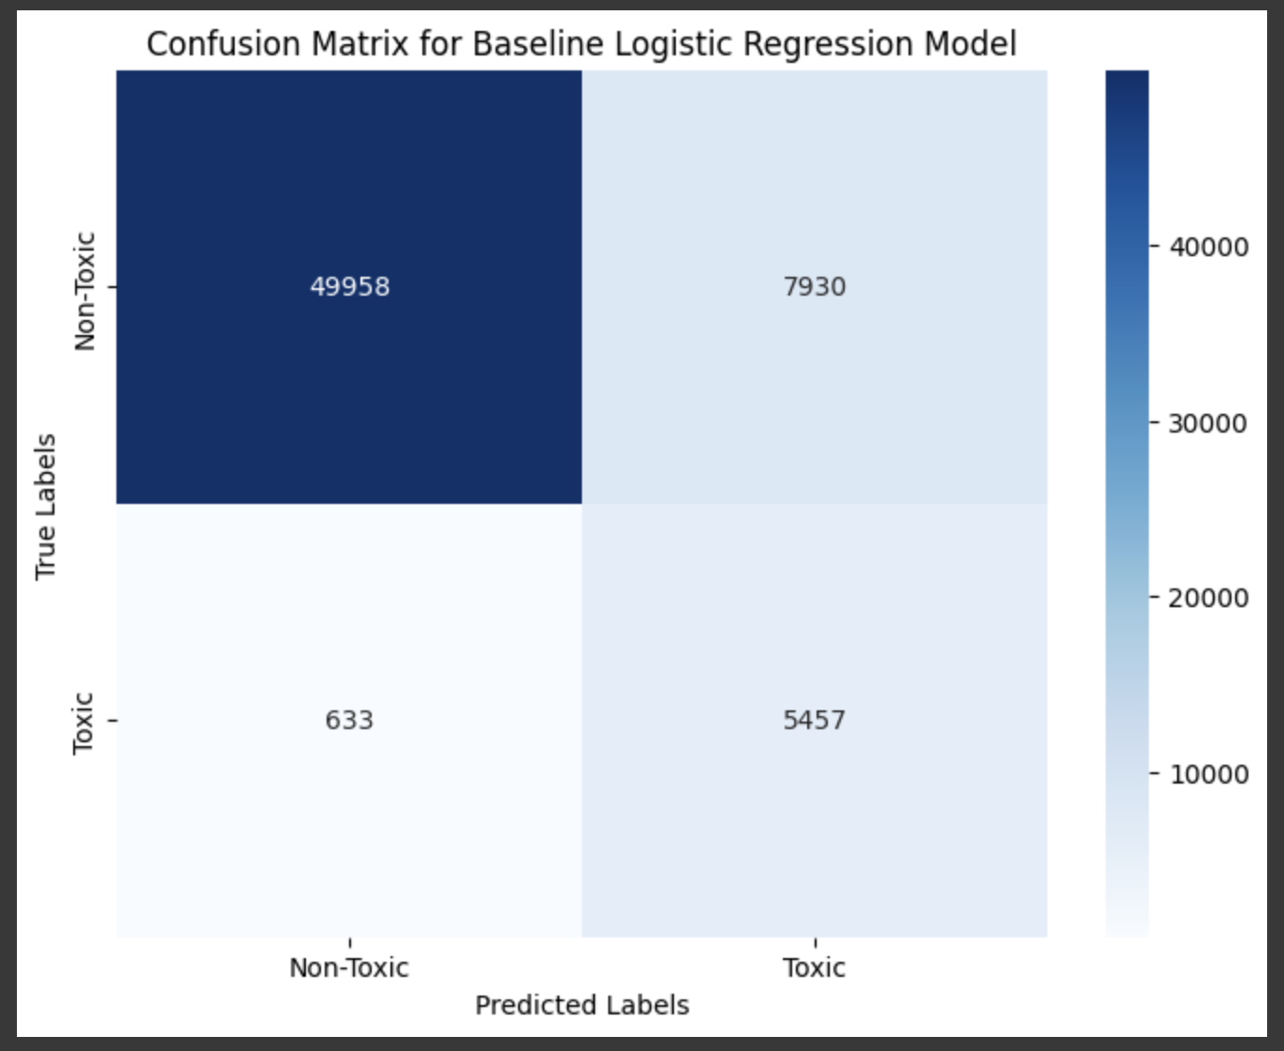
2. Baseline Model: Linear Regression
Achieved overall accuracy of 86%.
Strengths:
Model is excellent at identifying non-toxic comments: high precision (0.99) and F1 score (0.92) for class 0.
The recall for toxic comments (1) is also high (0.90), meaning the model is good at finding toxic comments.
Weaknesses:
The precision for toxic comments is low (0.41), indicating the model misclassified many non-toxic comments as toxic.
This can be typical for imbalanced datasets where the majority class dominates the model’s focus.
Notes:
Strengths: The model is excellent at identifying non-toxic comments, as seen by the high precision (0.99) and F1 score (0.92) for class 0. The recall for toxic comments (1) is also high (0.90), meaning the model is good at finding toxic comments.
Weaknesses: The precision for toxic comments is low (0.41), indicating the model misclassified many non-toxic comments as toxic. This can be typical for imbalanced datasets where the majority class dominates the model’s focus.

Slide 6
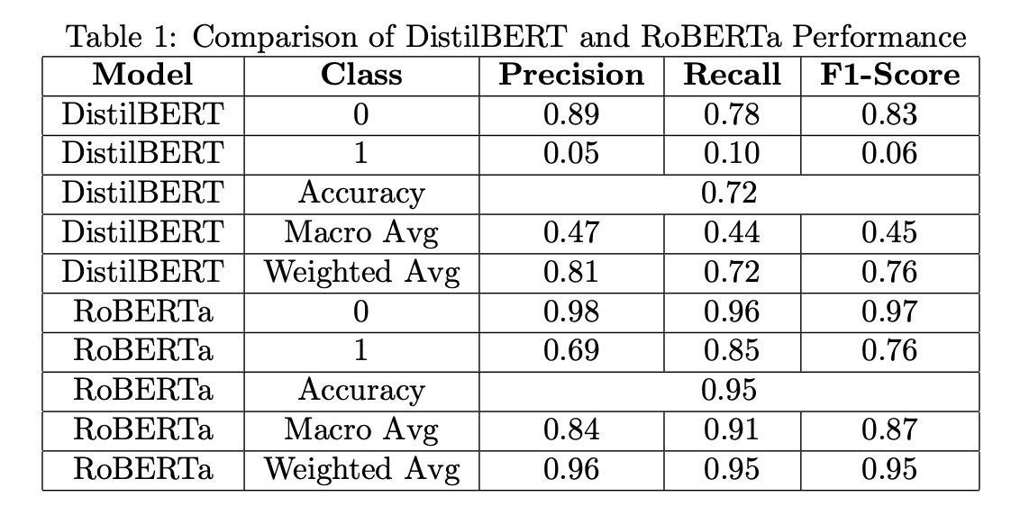
3. Advanced Transformer Models
DistilBERT: Chose this model as it is a smaller, faster, and lighter version of BERT achieved through knowledge distillation. It retains 97% of BERT’s language understanding capabilities while being 60% faster and 40% smaller.
RoBERTa_toxicity_classifier – pre-trained model with 2 million examples
DistilBert used 8.52 MB of additional memory during inference
RoBERTa_toxicity_classifier used 9.81 GB, worth the expense given the results
Notes:
Macro Average
What it does: Takes the average of the metric (e.g., precision, recall, F1-score) for each class without considering class imbalance (i.e., treats all classes equally).
Weighted Average
What it does: takes the average of the metric (e.g., precision, recall, F1-score) for each class, weighted by the number of samples in each class.

Slide 7

Advanced Transformer Models Evaluation
DistilBERT vs. RoBERTa:
DistilBERT struggles significantly with identifying ”toxic” com- ments (low precision and recall).
RoBERTa performs substantially better, especially on the ”toxic” class, with an F1-Score of 0.76 compared to DistilBERT’s 0.06.
Overall Performance:
RoBERTa is far superior, with an overall accuracy of 0.95 and a balanced weighted F1-Score.
DistilBERT has acceptable accuracy (0.72) but fails to generalize well to the minority ”toxic” class.
Improve DistilBERT by fine tuning it with Sentiment Analysis.
Notes:
The F1 score is the harmonic mean of precision and recall:

Slide 8

4. Adding Sentiment Analysis as a Feature
Added as feature in Baseline model (Linear Regression):
Improves Performance: With sentiment, the accuracy increases dramatically from 0.39 to 0.87.
The precision and recall for toxic comments (Class 1) both improve
Adding Sentiment to Transformer Model:
DistilBERT: it did not improve its ability to identify toxic comments.
Sentiment analysis may not contribute additional discriminatory power for the task of toxicity detection in this setup.
The model most likely is already capturing features correlated with sentiment implicitly, making the explicit addition redundant.
Notes:
The F1 score is the harmonic mean of precision and recall:

Slide 9
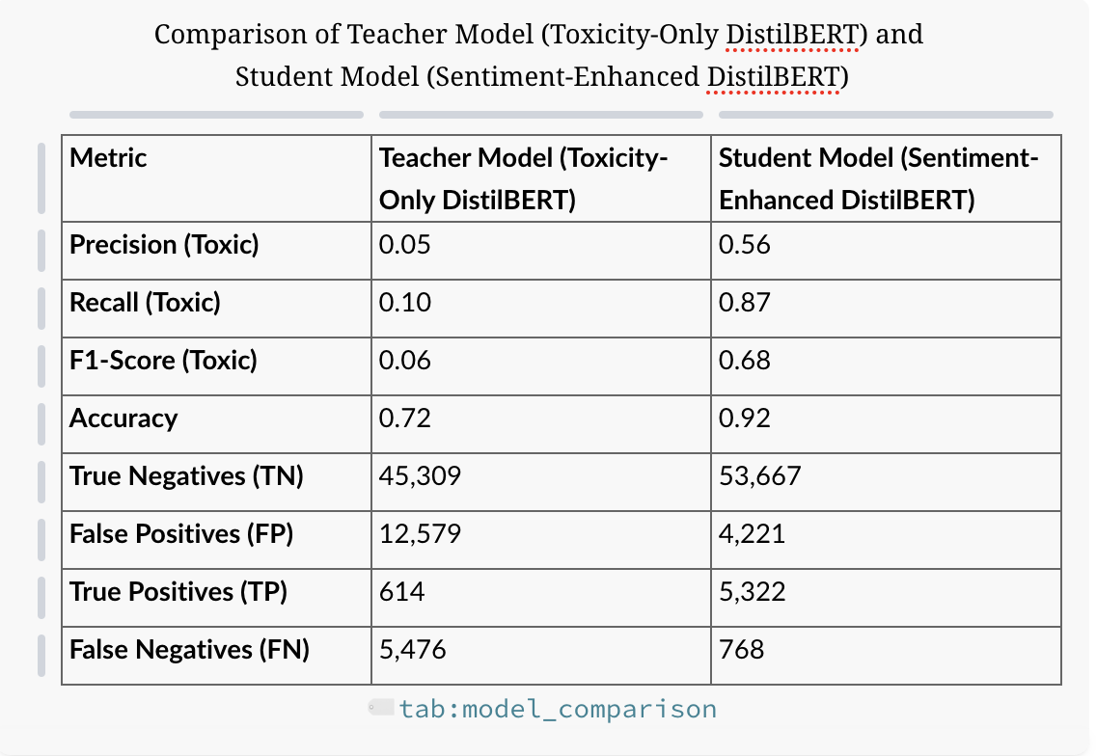

4.1 “Distillation of the Distilled” Model Experiment
Added Sentiment Weighting seeking efficiencies for a transformer model in a resource-constrained environment
Notes:
The student model vastly outperforms the teacher model across all metrics, showing the benefit of sentiment-enhanced training. The confusion matrix comparison highlights fewer false negatives and false positives in the student model.
The teacher model struggles with identifying toxic comments, as reflected by the low precision, recall, and F1-score for the toxic class.
Accuracy is high due to the class imbalance favoring the majority non-toxic class.
The student model significantly improves upon the teacher model, especially for the toxic class.
Higher precision, recall, and F1-score for the toxic class indicate that sentiment-enhanced training helps detect toxicity more effectively.
Accuracy improvement is evident, with better discrimination of both classes.

Slide 10
4.1 “Distillation of the Distilled” Model Experiment
Key Takeaways:
Incorporating sentiment data in the student model enhances its ability to detect toxicity, resulting in better precision, recall, and overall F1-score.
The student model demonstrates improved generalization with fewer errors compared to the teacher model.
Training a smaller model (student) using knowledge distillation and sentiment-aware weighting is effective for tasks involving subtle and nuanced predictions like toxicity detection.
Added Sentiment Weighting seeking efficiencies for a transformer model in a resource-constrained environment
Notes:
The student model vastly outperforms the teacher model across all metrics, showing the benefit of sentiment-enhanced training. The confusion matrix comparison highlights fewer false negatives and false positives in the student model.
The teacher model struggles with identifying toxic comments, as reflected by the low precision, recall, and F1-score for the toxic class.
Accuracy is high due to the class imbalance favoring the majority non-toxic class.
The student model significantly improves upon the teacher model, especially for the toxic class.
Higher precision, recall, and F1-score for the toxic class indicate that sentiment-enhanced training helps detect toxicity more effectively.
Accuracy improvement is evident, with better discrimination of both classes.

Slide 11

Future Work
Next Steps:
Further fine-tune the student model to reduce errors for positive sentiment cases. Test RoBERTa as the teacher model.
Explore additional features (e.g., context or user behavior) to further improve toxic class predictions.
Apply this methodology to other domains with imbalanced data and nuanced prediction requirements.

Slide 12


Questions? Feedback?
melody_masis@Berkeley.edu

